Slide 1


Data Dive: Unraveling Insights from Social Buzz's Content Landscape

Slide 2


Today's agenda
Project recap
Problem
The Analytics team
Process
Insights
Summary

Slide 3


Unjj
Social Buzz, founded by ex-engineers, is a content-centric platform with over 500 million monthly users, emphasizing anonymity and diverse content reactions beyond likes. Scaling rapidly, they seek external expertise for an imminent IPO. The tsaks to be performed are:
An Audit of Social Buzz’s Big data practice.
Recommendations for successful IPO.
Analysis of content categories that highlights Top 5 categories with largest aggregate popularity.
Project Recap

Slide 4


Problem
Rapid growth strains resources.
Managing massive unstructured data.
Lack of experience in managing big data.
Need for efficient data center and technology audit.
Identifying weak spots in technology.
How can we optimize resource allocation for scalability?
What strategies/tools enhance unstructured data processing?
What are the best practices from large corporations for big data?
How can we improve technology architecture for efficiency?

Slide 5
Andrew Fleming (Chief Technology Architect)
The Analytics team
Marcus Rompton (Senior Principle)
Michelle Grove (Data Scientist)
Ambrish Tripathi (Data Analyst)

Slide 6

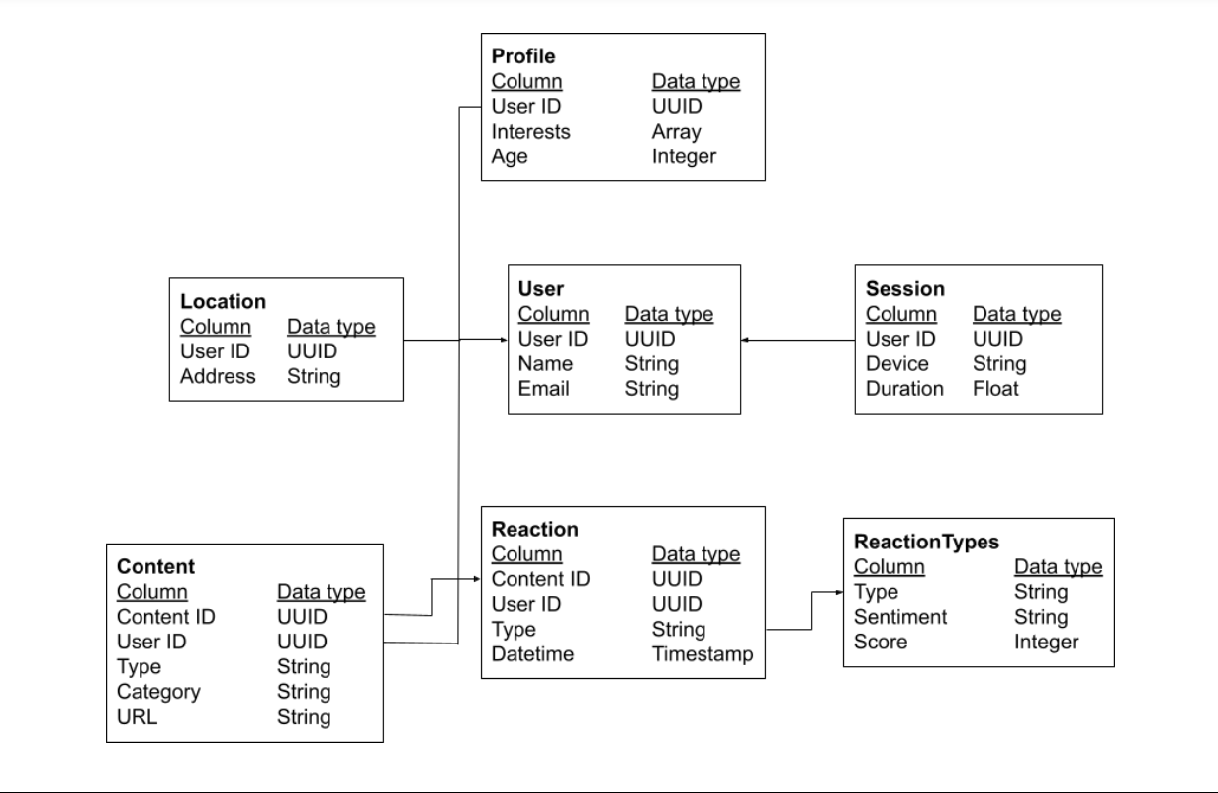
Data Model
According to the problems we need to solve we have used the required Dataset.
Reactions
Content
ReactionType

Slide 7

Process
1
Identified Business Problems and understood the requirements.
2
Collected the relevant datasets required to solve the problem. Cleaned the data using excel and removed unnecessary data.
3
Created the relationship between datasets and created model using unique and common keys.
4
Performed Analysis and Cisualized data on Power BI
5
Extracted Insights

Slide 8

Insights
Top 5 Categories:
Animals
Science Healthy Eating
Technology
Food
There are total 16 Unique categories
There 1895 reactions for Animal which is the most popular category.
January was the month with most posts. 781 posts were posted.
Sentiment analysis:
56.19% Positive Reactions on Posts.
31.31% and 12.5% were Negative and Neutral.
January, August and December were the months with highest engament.

Slide 9
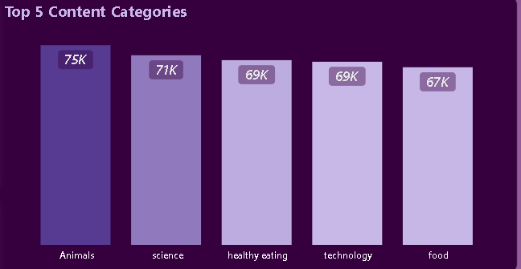

Bar Chart: Top 5 Categories
Recommendation: Allocate resources for creating more content in the top-performing categories.
Suggestions: Conduct audience surveys to identify specific subtopics or trends within these categories for more targeted content.
Based on the preferences we can push such subplots to increase more engagement.

Slide 10
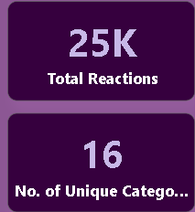
KPIs:
Number of Reactions
Number of Unique Categories
Suggestions:
Develop guides or tutorials to educate users on the available content categories.
Establish community feedback platforms for users to suggest and vote on new content categories.
Solutions:
Create in-app notifications or dedicated sections to showcase lesser-known categories.
Implement user-generated category suggestions with a voting mechanism.

Slide 11
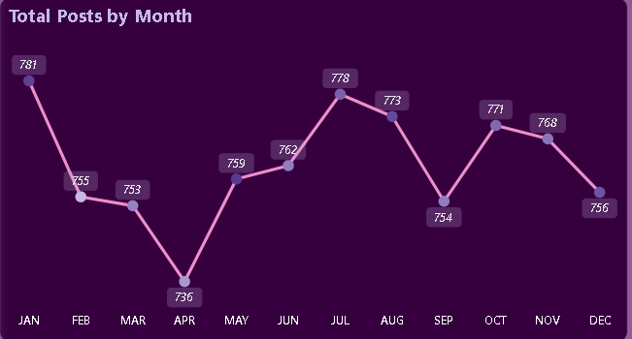
Line Chart: Total Posts By Month
Suggestions:
Collaborate with influencers or run targeted marketing campaigns to maximize platform visibility
Introduce content creation challenges to stimulate posting during slower months.
Solution: Design campaigns that inspire users to create and share content with specific themes.

Slide 12
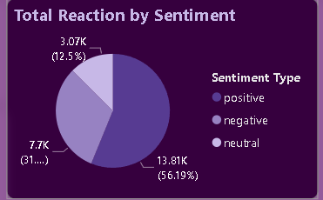
Pie Chart: Sentiment Analysis – Reactions By Sentiment type
Suggestions:
Invest in advanced sentiment analysis algorithms.
Implement a content moderation system based on sentiment analysis.
Solution and Action:
Collaborate with data scientists to improve the platform's ability to accurately analyze and categorize sentiments.
Flag or review content with consistently negative sentiments for additional scrutiny.

Slide 13
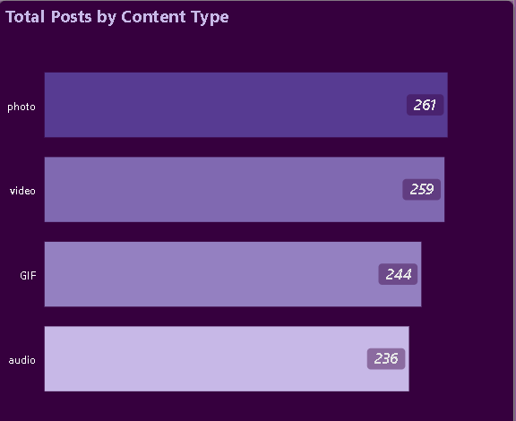
Horizontal Bar Chart: Content type Distribution – posts By Content Type
Suggestion:
Develop an analytics dashboard for content creators to track the performance of their content types.
Action:
Provide insights into the reach and engagement of different content types to guide creators.

Slide 14
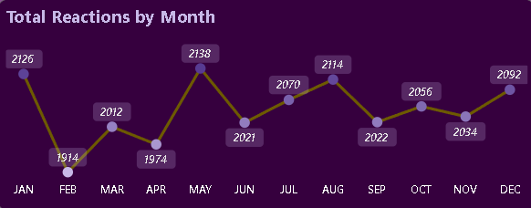
Line Chart: Total Reactions By Month
Suggestion: Utilize push notifications strategically.
Action: Send notifications during specific months to encourage users to share content, react, or participate in community activities.

Slide 15


Social Buzz's audit revealed challenges in resource allocation, unstructured data management, and technology efficiency. Insights include top 5 categories (Animals, Science, Healthy Eating, Technology, Food), 16 unique categories, and peak engagement in January. Sentiment analysis showed 56.19% positive reactions. Next steps involve refining technology architecture and implementing best practices. The IPO preparation is on track with identified strengths and areas for improvement. The Analytics team successfully navigated the complexities, extracting actionable insights for enhanced scalability.
Analysis:
Identified business problems.
Conducted data cleaning and modeling.
Utilized Power BI for data visualization.
Insights:
Top 5 categories: Animals, Science, Healthy Eating, Technology, Food.
16 unique categories.
Highest engagement in January.
Next Steps:
Refine technology architecture.
Implement big data best practices.
Prepare for IPO based on identified strengths and improvements.
Summary

Slide 16

Thank you!
ANY QUESTIONS?

